Slide 1
Chapter One - What is a Model and Why Model Data
Introduction to Database Systems Modeling and Administration James M. Reneau Ph.D.

Slide 2
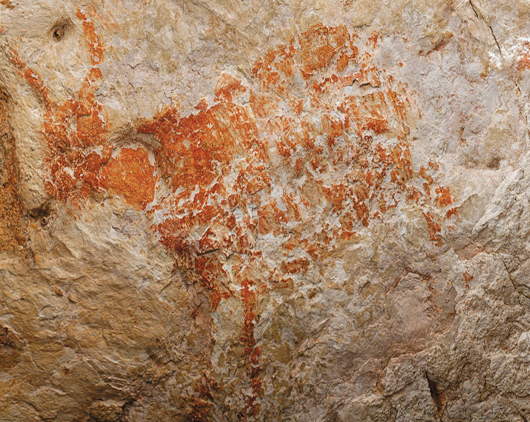
What is a Model
Description or analogy
Help us to visualize
Been doing it for thousands of years - even on cave walls.
Photo by Luc-Henri Fage, www.fage.fr

Slide 3
Models Take Many Different Forms
Drawings
Sketch,
Engineering / blue print.
Prototypes
Small,
Specific purpose.
Have a fidelity
Level of detail / reality.

Slide 4
Data, Information, and Knowledge
Data - Factual information, the raw facts collected in the business.
Information - Distilled data, summarized into meaning, reports, dashboards.
Knowledge - Information internalized by the user into insight.

Slide 5
What is a Data Model?
Describes data - does not contain actual data values.
Usually graphical.
Concise as possible.
Used to facilitate communicate between
Shareholders, and
Technical people.

Slide 6
A Data Model’s Life Cycle
Incremental - a process that grows in detail - over time.
Iterative - living document that grows and changes as we develop and maintain.
Collaborative - open communication with all stakeholders- not created in a vacuum.

Slide 7
Fidelity in a Data Model
Enterprise Data Model - models the entire organisation - a model of models and how they all connect and share data.
Conceptual Model - initial understanding of the entities and relationships in the system.

Slide 8
Fidelity in a Data Model (Continued)
Logical Data Model - a complete understanding of the entities, attributes, and relationships.
Physical Data Model - how the data is actually stored in the database.

