Slide 1
Chapter Two - Entities
Introduction to Database Systems Modeling and Administration James M. Reneau Ph.D.

Slide 2
What is an Entity?
Entities are what we model they represent the things we model.
Drawn in the CDM as a rounded rectangle with name in center.
Examples:
Actions
Events
People
Items

Slide 3
Four Types of Data in Entities
Data fall into four major categories:
Categorical,
Resource,
Event / Transaction, and
Event / Transaction Detail.

Slide 4
Categorical Data Entities
Used to group other data elements.
Rarely change.
Report categories.
Examples:
gender,
language spoken,
menu category,
movie genre,
shirt size…

Slide 5
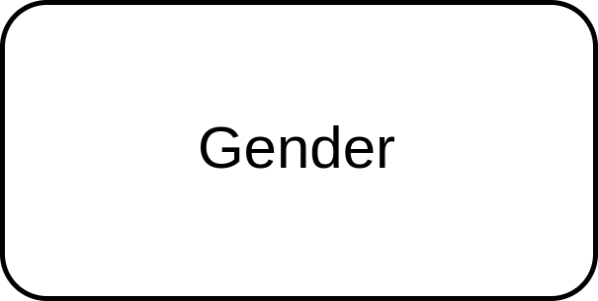
Gender Entity (Categorical)
Code | Description
M | Male
F | Female
X | Other
NA | Not Answered
Categorical - Gender Data
Categorical - Gender ORM

Slide 6
Resource Data Entities
Resource data represents
data that events happen to
or because of.
It is slow changing.
Examples include:
customers,
vendors,
locations,
inventory items,
…

Slide 7
Company Entity (Resource)
company_id | description | taxid
1 | FOO Consolidated | 55-5559999
2 | BAR Exploration | 55-5559988
99 | XYZ Sales | 55-5559977
Resource - Company Data
Resource - Company ORM

Slide 8
Event / Transaction Data Entities
Temporal (related to time) in nature.
Event data is created and collected when something happens.
For example:
a new sales order,
a meeting is scheduled,
a package is received,
a general ledger entry is posted,
…

Slide 9
Ledger Transactions (Event) - Data
transaction_uuid | transactiondatetime | company_id | description
9e755caf-e250-11ef-8487-047c16fd53a0 | 2024-09-22 09:34:56 | 1 | Initial Stock Purchase
afde0b67-e250-11ef-8487-047c16fd53a0 | 2024-09-22 11:33:30 | 1 | Purchase Inventory
Event - Ledger Transaction Data

Slide 10
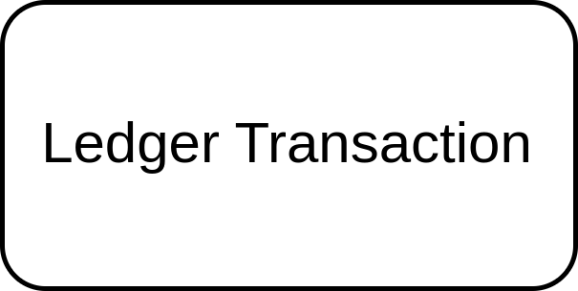
Ledger Transactions (Event) - CDM Diagram
Event - Ledger Transaction ORM

Slide 11
Event / Transaction Detail Data
Small details of an event or transaction.
Lots and lots of them.
Summarized to make totals and balances.
Examples:
debits and credits for a general ledger entry,
items and quantities of items on an order.
…

Slide 12
Ledger Transactions Details - Data
transaction_uuid | account_id | amount
9e755caf-e250-11ef-8487-047c16fd53a0 | 100 | 1000.0
9e755caf-e250-11ef-8487-047c16fd53a0 | 300 | -1000.0
afde0b67-e250-11ef-8487-047c16fd53a0 | 100 | -500.0
afde0b67-e250-11ef-8487-047c16fd53a0 | 190 | 500.0
Transaction - Ledger Transaction Data

Slide 13
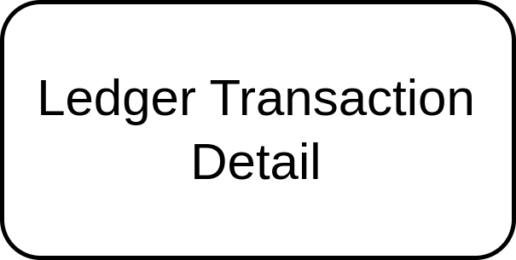
Ledger Transactions Details - CDM Diagram
Transaction Detail - Ledger Transaction ORM

Slide 14
Entities are Metadata
Metadata => Data about Data
Use metadata for:
Clarity - meaningful names that follow business rules.
Accuracy - precise and reviewed by subject-matter experts. Completeness - need to be fully defined.

