Slide 1
Chapter Three - Relationships Between Entities (Conceptual Data Model)
Introduction to Database Systems Modeling and Administration James M. Reneau Ph.D.

Slide 2
Introduction
Relationships
Conceptual Data Model (CDM)
Urinary, binary and ternary relationships
Cardinality of relationships.
Specialization and Generalization of Entities

Slide 3
Arity of Relationships
Arity means the count of values.
Three most common types of relationships in a CDM:
binary relationships,
unary relations, and
ternary relationships

Slide 4
Binary Relationship
A binary relationship exists between two entities.
The box in the middle (divided into two parts) describes the relationship.
Binary Relationship - Machine to Parts

Slide 5
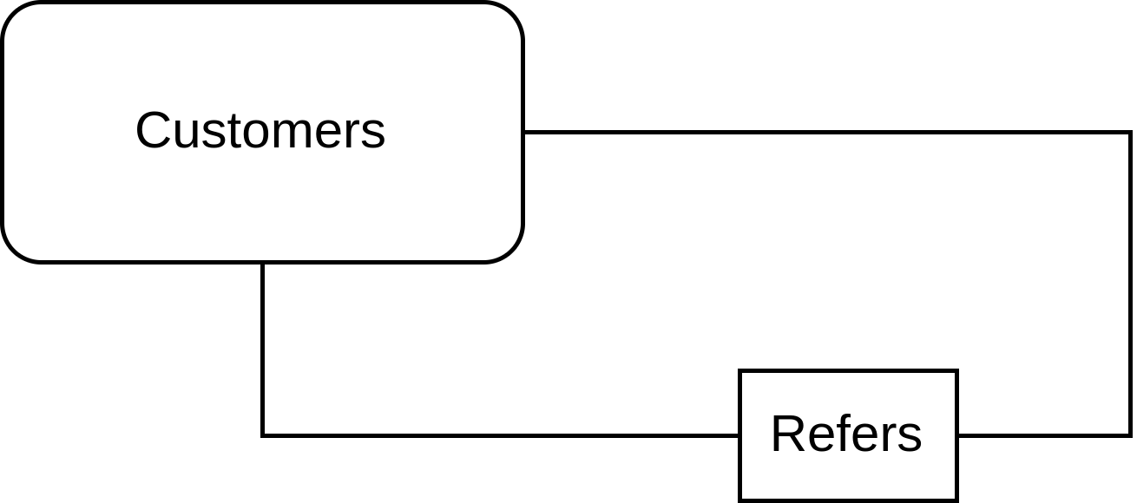
Unary (recursive) Relationship
In a unary relationship, an entity can refer to itself (recursive).
Example:
part replaces another part,
employee manages another employee,
…
Unary Relationship - Customer Referals

Slide 6
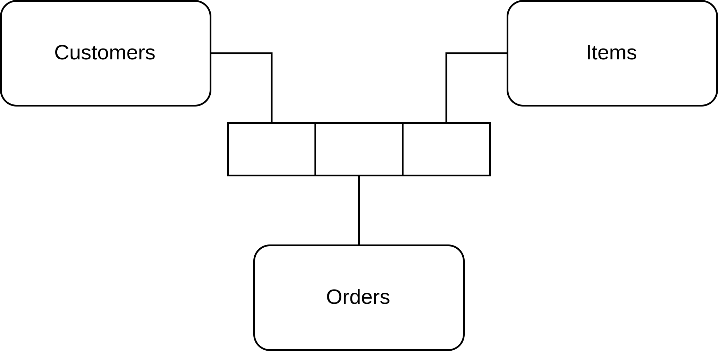
Ternary Relationship
A ternary relationship exists between three entities.
Something that depends on two entities.
Can be reduced into two binary relationships with one entity in middle.
Ternary Relationship - Customer, Orders, Items

Slide 7
Cardinality of Relationships
Cardinality is the count of entities on each side of a relationship.
Notice that there is a bar above the left half of the binary relationship symbol. This bar means “At Most One”.
Bar may be over either, both, or none.
Conceptual Data Model - One to Many - Customer to Orders

Slide 8
Conceptual Data Model (CDM) - Example
A person owns zero or more vehicles.
A vehicle is owned by one person.
CDM - One to Many - Person to Vehicle

Slide 9
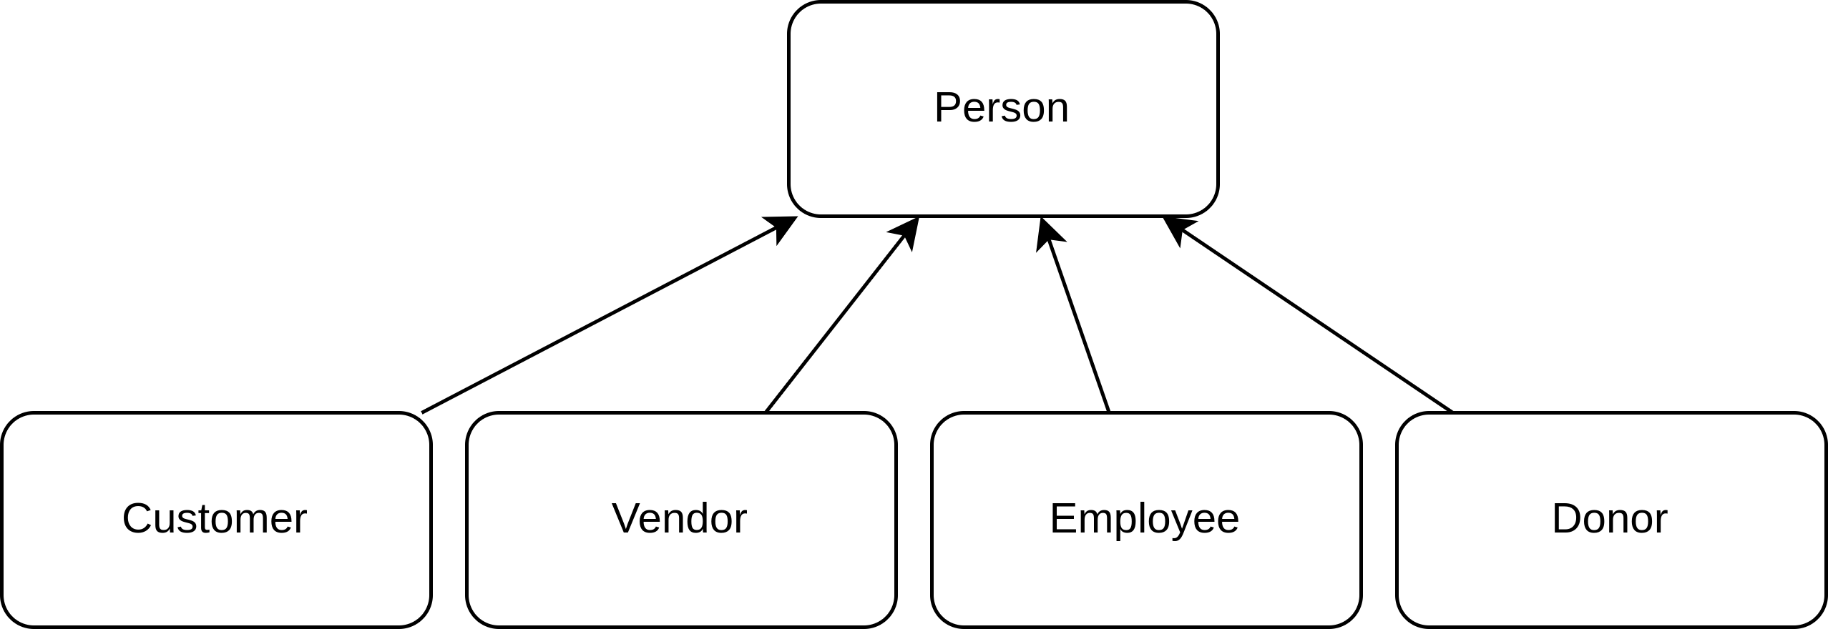
Generalization
Entities may be generalized with an “is a” relationship.
Drawn with arrow from special to general entity.
Example
Vendor is a person.
Customer is a person.
…
Person may be several.
CDM - Non-Exclusive Generalization - People

Slide 10
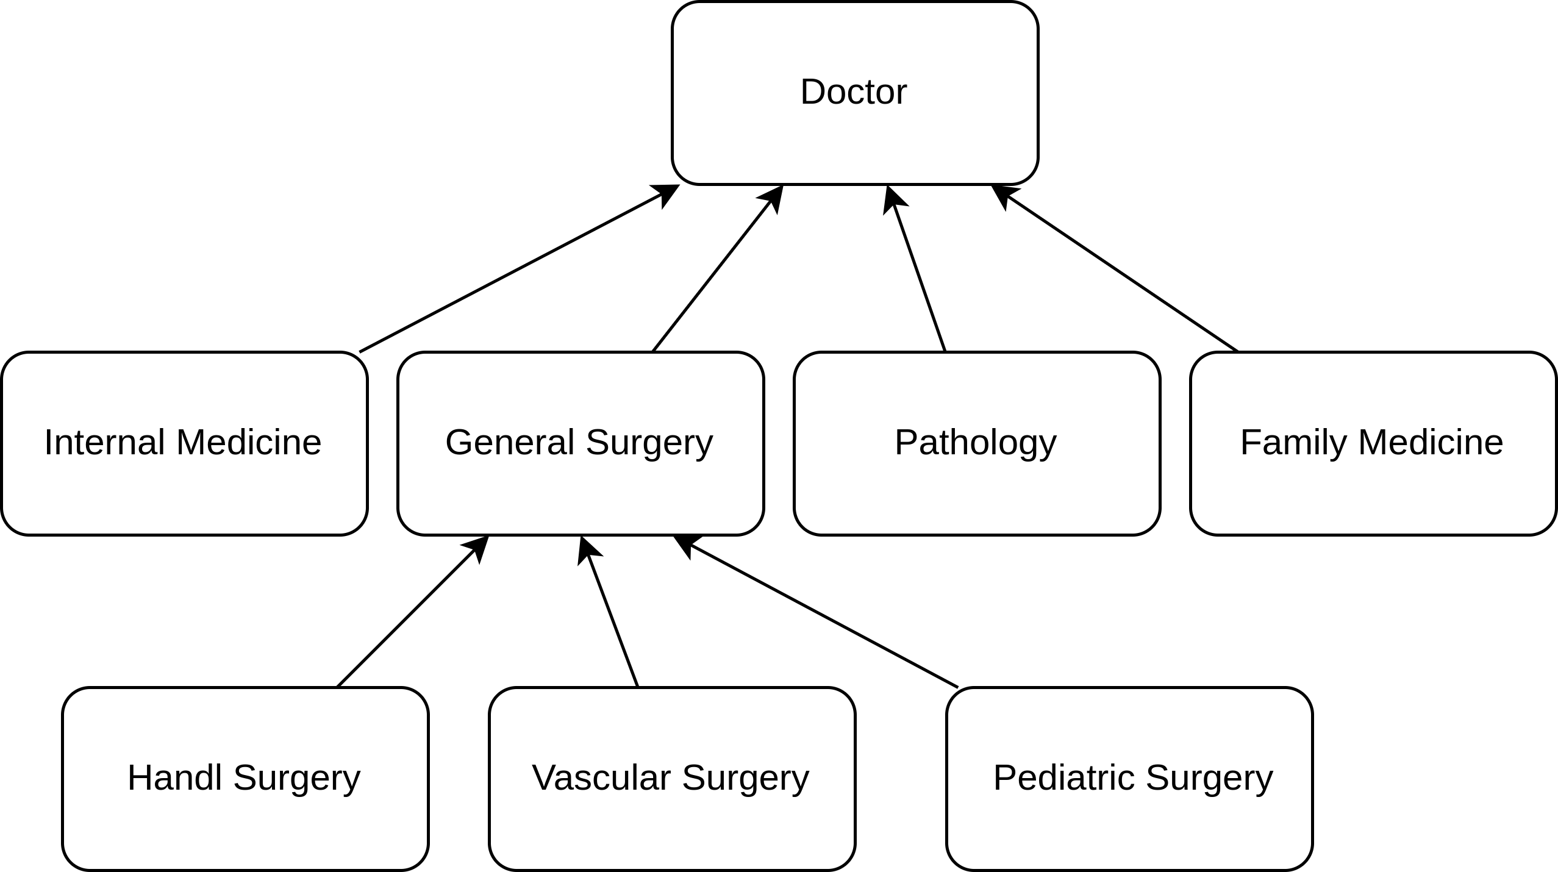
Specialization
We may go the other direction and specialize.
This is a “has a” relation.
Arrow still points toward general.
Example:
Vehicles have types
car, truck, …
Pets have species
cat, dog, …
CDM - Non-Exclusive Specialization - Doctors

Slide 11
Specialization Hierarchy
Generalization and Specialization are part of a Specialization Hierarchy.
Hierarchy may be:
Non-Exclusive
Generalization may have several specializations.
Several specializations may be one generalized entity.
Exclusive
A generalization may only be zero or one specialization.

Slide 12
Drawing Exclusive Specialization Hierarchy
Exclusive - has dotted line with circled ‘x’ across arrow.
Non-Exclusive - no notation on arrows.
CDM - Exclusive Specialization - Vehicles

