Slide 1
Chapter Four - Attributes
Introduction to Database Systems Modeling and Administration James M. Reneau Ph.D.

Slide 2
Attributes
Attributes are the properties of an entity.
Actual data values that make each instance of an entity different.
An attribute is given a name (column name).
Should be atomic.
Has a specific domain or range of values.

Slide 3
Attribute Origin
Natural Attributes
Inherent property of the entity.
An entity knows these things
Examples include:
name / description,
address / location,
weight / size,
Synthetic Attributes
Meaning to the system or database.
Three broad categories:
sequentially assigned identifiers,
random sequences (UUID), or
abbreviations.

Slide 4
Naming Attributes and Entities
No standard.
Your institution or employer may have standard.
Common ways to write identifiers:
PascalCase - The first letter of each word is capitalized.
camelCase - The first letter of the second and subsequent word is capitalized.
snake_case - No letters are capitalized, with underscores.
lowercase - All letters are lower case and no spaces.

Slide 5
Recommendations
Be consistent - inconsistency will slow development.
Names should begin with a letter and contain only letters, numbers, and underscores.
One style should be adopted.
Abbreviations must be consistent.
Names should be singular or plural.

Slide 6
Domain of an Attribute
Domain is the valid range of attribute.
General types of storage:
fixed precision numbers,
floating point numbers,
strings, Boolean values,
datetimes, and
binary objects.

Slide 7
Fixed Precision Number
An integer (whole number):
16 bit (-32,768 through 32,767),
32 bit (-2,147,483,648 through 2,147,483,647), or
64 bit (-9,223,372,036,854,775,808 through 9,223,372,036,854,775,807) signed number.
A fixed precision decimal number
Specified number of digits before and after the decimal point.

Slide 8
Floating Point Number
Stored as approximate value
Scientific notation with:
significand and exponent.
Large and very small magnitudes.
limited precision.

Slide 9
String
Sequence of letters, numbers, and other symbols.
In SQL, surrounded in ‘single quotes’.
Variable length with a maximum storage length or a fixed length.

Slide 10
Boolean
True and false value
Named for mathematician George Boole
May be stored as own type or as an integer
0 or 1

Slide 11
Date and Time
DATETIME
A single value including a date, time, and timezone.
Expressed in ISO format (YYYY-MM-DD HH:MM:SS.SSS).
Databases may have types for Date and Time alone.

Slide 12
Binary Objects
Binary Large Object (BLOB)
Used to store:
sound,
video,
encrypted strings, or
other binary data.

Slide 13
Null
Attributes may be allowed to be empty or required
The empty value is NULL.
NULL represents nothingness.

Slide 14
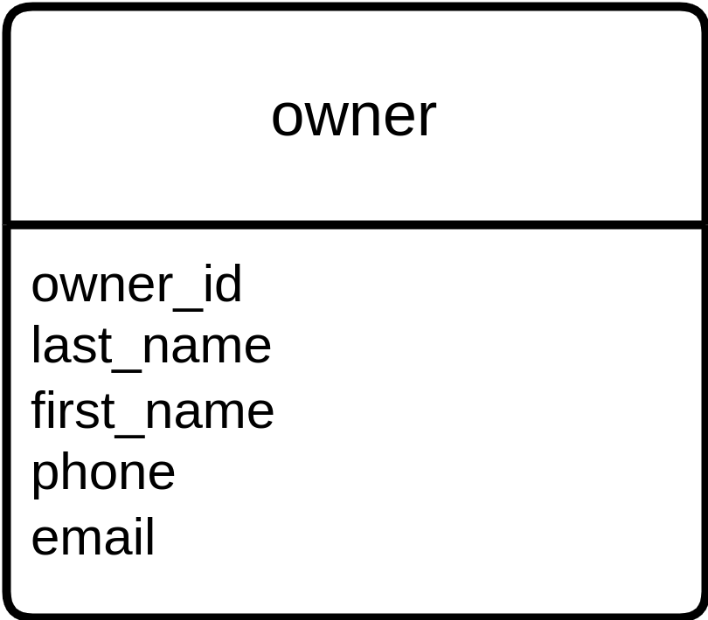
Entity Relationship Diagram - Entity Shape
Logical Data Model (LDM).
“Crows Foot Entity Relationship Diagram” or simply ERD.
Entity Shape
rectangle divided into sections;
top section with name and
bottom section with attributes.
Owner Entity - Entity Shape

Slide 15
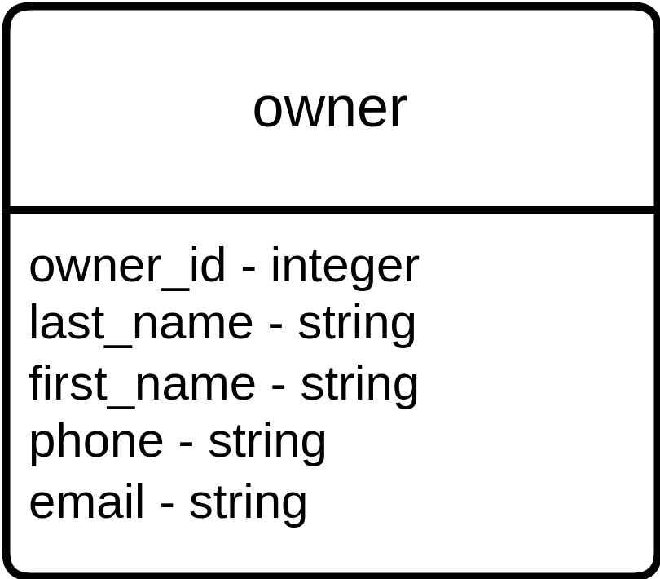
Entity Relationship Diagram - Entity Shape (2)
Entity Shape with attributes and domains.
As we have more detail we will add it to the lower half.
Owner Entity - Entity Shape with Types

