Slide 1
Chapter Four - Keys
Introduction to Database Systems Modeling and Administration James M. Reneau Ph.D.

Slide 2
What is a Key?
A key is
an attribute or several attributes
taken together to uniquely identify a row.
Keys are used to:
create indexes for fast lookup,
to retrieve a specific row, and
to create relationships between entities.

Slide 3
Properties of a Key
A key MUST be:
unique,
non-volatile,
minimal,
not null, and
secure.

Slide 4
Key is Unique
Must identify a single row.
May be a single attribute or composite.
Examples include:
order number,
serial number, or
other sequentially assigned identifiers.

Slide 5
Key is Non-volatile
Do not change.
Bad examples include:
phone_number (unique maybe but may change)
last_name + first_name (not unique may change)
email (may be unique but may change)

Slide 6
Key is Minimal
Small as possible.
Especially true for composite keys.
Combine the least number of attributes possible.

Slide 7
Key is Not NULL
NULL may not be a key.
NULL may not be part of a composite key.
NULL + anything is still NULL. Won’t work.

Slide 8
Key is Secure
No private or confidential attributes.
Insecure attributes (bad keys) include:
Government Issued Identifier
Social Security Number,
Passport Number,
Driver’s License Number
Personally Identifiable Information (PII)
Bad practice even though it may meet the other criteria for a good key.

Slide 9
Simple or Composite Key
Simple Key
A single attribute may be a good key.
Meet all criteria.
Examples:
An identifying abbreviation,
UPC,
customer number,
member code, …
Composite Key
Made by concatenating multiple attributes together.
Compound Key - Composite key made of all foreign keys.
will learn more later in relationship chapter.

Slide 10
Composite Key Example
Example:
Entity contains the inventory we have in our stores.
The attributes would be
store_number,
item_number, and
quantity_on_hand.
Concatenate store_number and item_number together into a composite key.
store_number | item_number | quantity_on_hand
12 | 345 | 4
12 | 1010 | 3
12 | 8765 | 8
34 | 345 | 3
34 | 1010 | 5
56 | 1010 | 4
56 | 8765 | 12
Store Inventory Data

Slide 11
Candidate Keys
A list of all possible keys for an attribute.
There may be more than one good key.
All will usually be used for indexing, searching, matching, and retrieval.
Some are:
single attributes
concatenated attributes (composite), or
surrogate keys.

Slide 12
Primary Key
One key to rule them all. (nerdy reference)
One of the candidate keys to become the master key.
Unique identifier used to implement relationships in database.
Usually the simplest of the candidate keys.
Sometimes a synthetic attribute.

Slide 13
Natural Keys
Keys that occur in the attribute’s data.
May be single attribute or concatenated keys.
Usually an entity knows this about itself.

Slide 14
Surrogate Keys
Attribute added with number or code as a candidate key.
Has no natural connection to attribute.
Often chosen as the primary key.
Used when
there is no good candidate key or
the concatenated primary key makes the database structure too complex.
There is no strict rule for use.

Slide 15
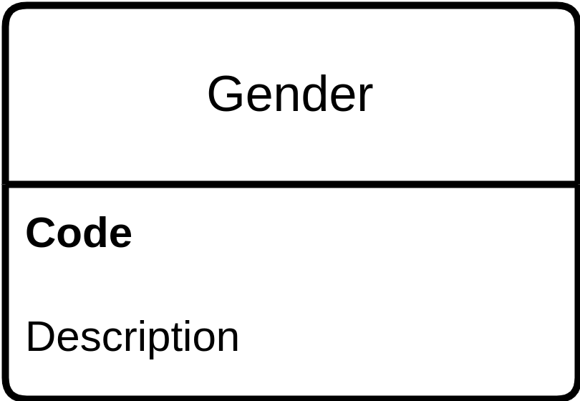
Adding the Primary Key to the LDM
There are several different ways:
Add the letters “PK” or an asterisk “*” to the attribute/attributes,
Mark in bold and listed first.
Categorical - Gender ERD

Slide 16
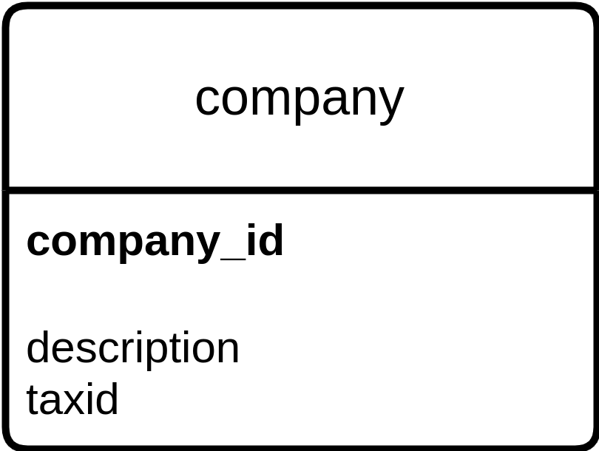
Key Example - Company
company_id | description | taxid
1 | FOO Consolidated | 55-5559999
2 | BAR Exploration | 55-5559988
99 | XYZ Sales | 55-5559977
Resource - Company Data
Resource - Company ERD

Slide 17
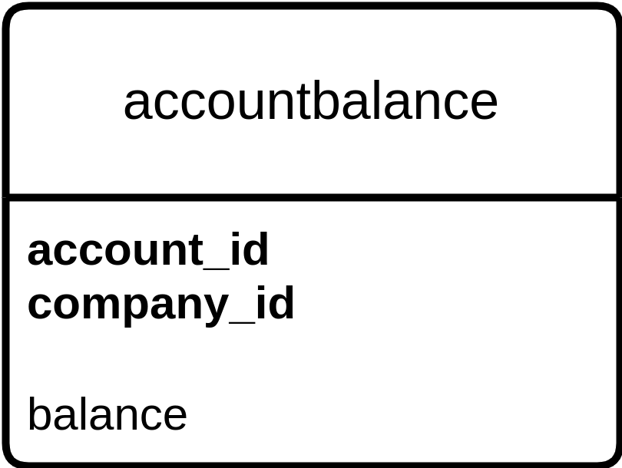
Key Example - Account Balance
company_id | account_id | balance
1 | 100 | 500.0
1 | 190 | 500.0
1 | 300 | -1000.0
Resource - Account Balance Data
Resource - Account Balance ERD

