Slide 1
Chapter Six - Logical Data Model (LDM)
Introduction to Database Systems Modeling and Administration James M. Reneau Ph.D.

Slide 2
Logical Data Model
Use the CDM and
Entities with attributes and primary key.
Add:
Relationships between entities with crows beet to shpw cardinality,
Foreign keys to connect entities,
Eliminate many to many relationships, and
Implement the specialization or generalization.

Slide 3
Information Engineering (IE) ERD
IE diagram ERD is a common way to draw
Logical Data Models (LDM), and
Physical Data Models (PDM).
Entities with attributes and keys from previous chapters.
Lines with special line end symbols to define the cardinality of a relationship.

Slide 4
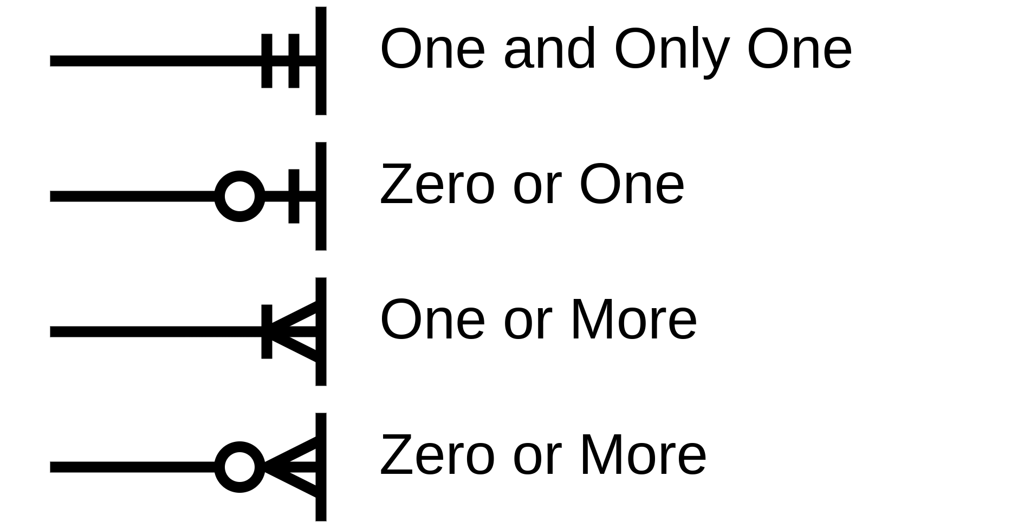
IE AKA Crows Feet
The Four Line Ends

Slide 5
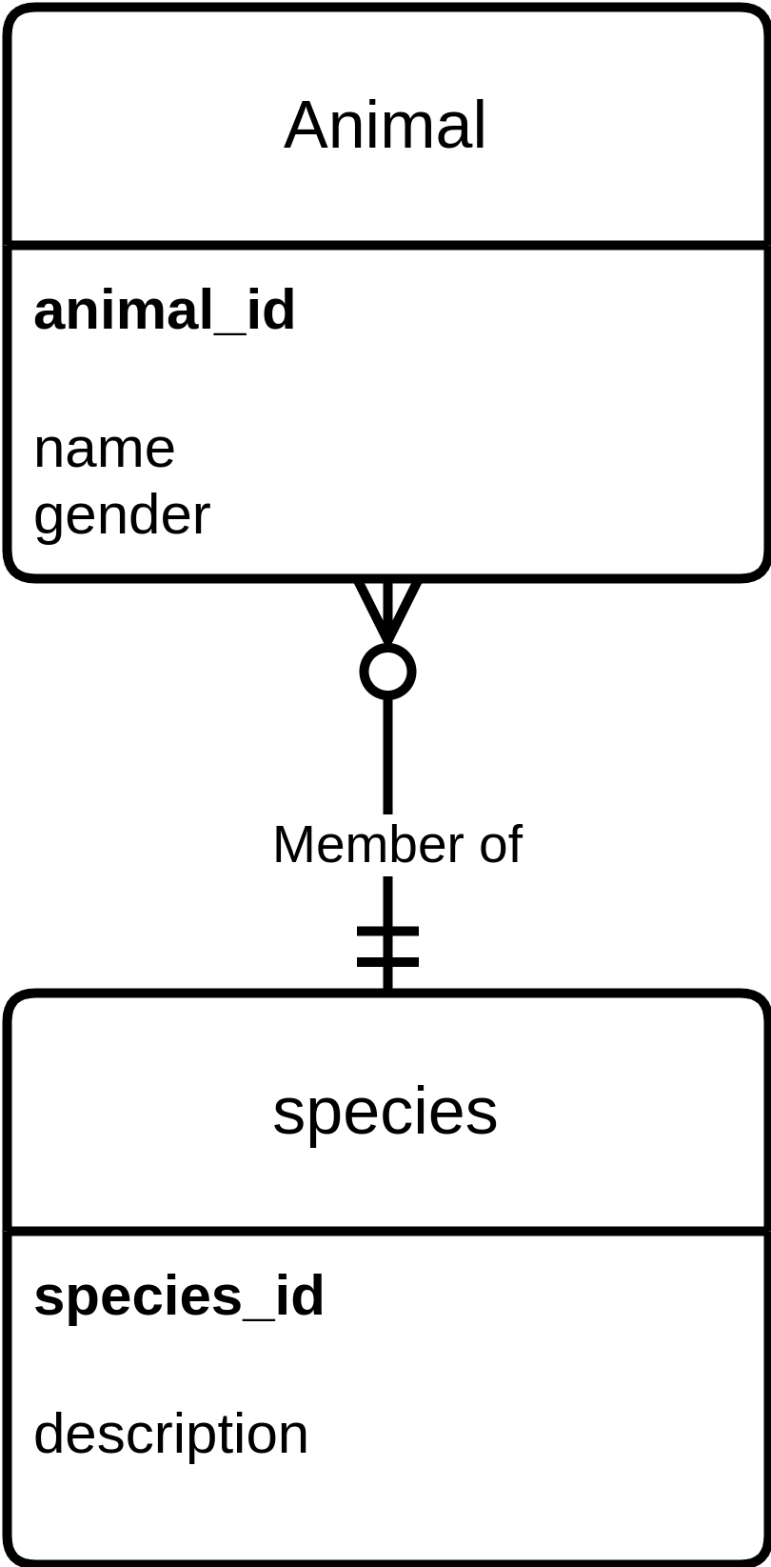
IE Relationships with Crows Feet
One symbol on each end of a relationship.
An optional description of the relationship.
This diagram can be read:
an animal is one and only one species and
a species may have zero or more animals.
Animal Species with Relationship

Slide 6
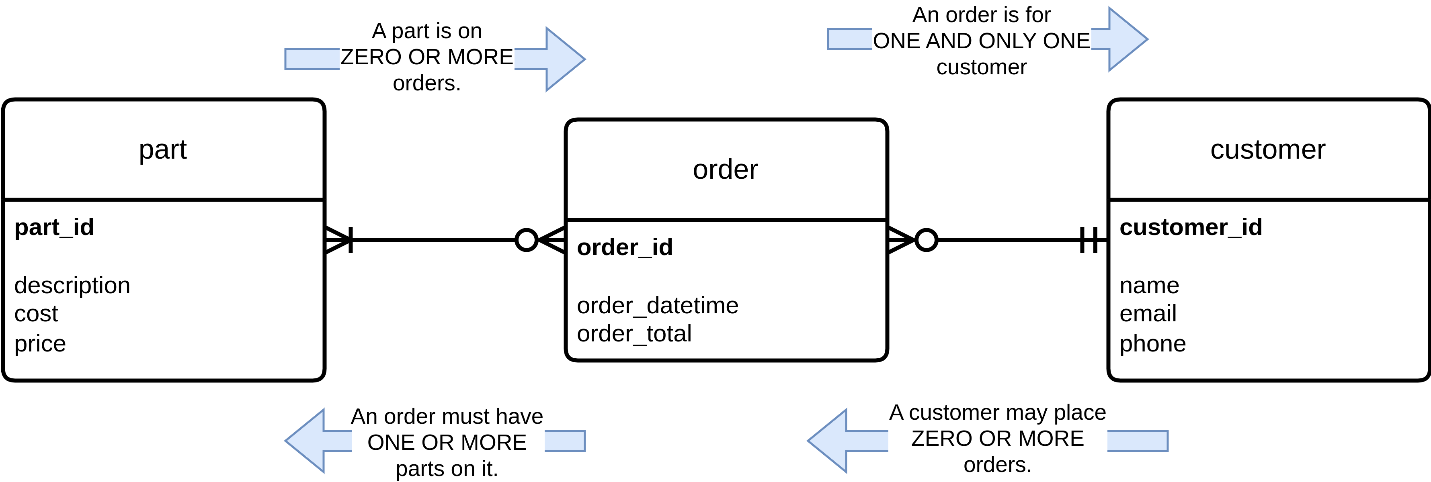
LDM
Part Order Customer with Relationships Explained

Slide 7
Foreign Key
To implement a one-to-one or one-to-many relationship:
primary key of the “one” table on the “many” table.
This is called a foreign key.
On our ERDs it will be marked with an ‘(FK)’ .

Slide 8
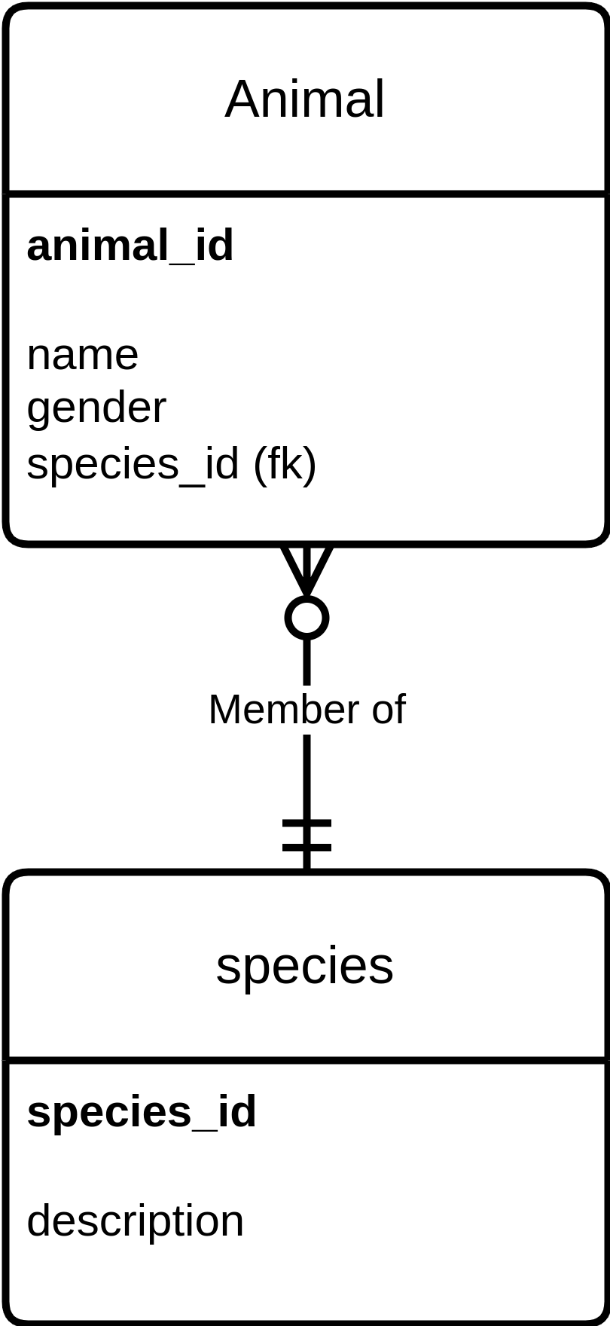
Foreign Key on LDM
LDM - Animal Species

Slide 9
Many-to-Many Relationships
Part has a many-to-many relationship to order
Problems:
Where do we put the foreign keys?
Where do we put the quantity ordered?
Are we missing an entity?

Slide 10
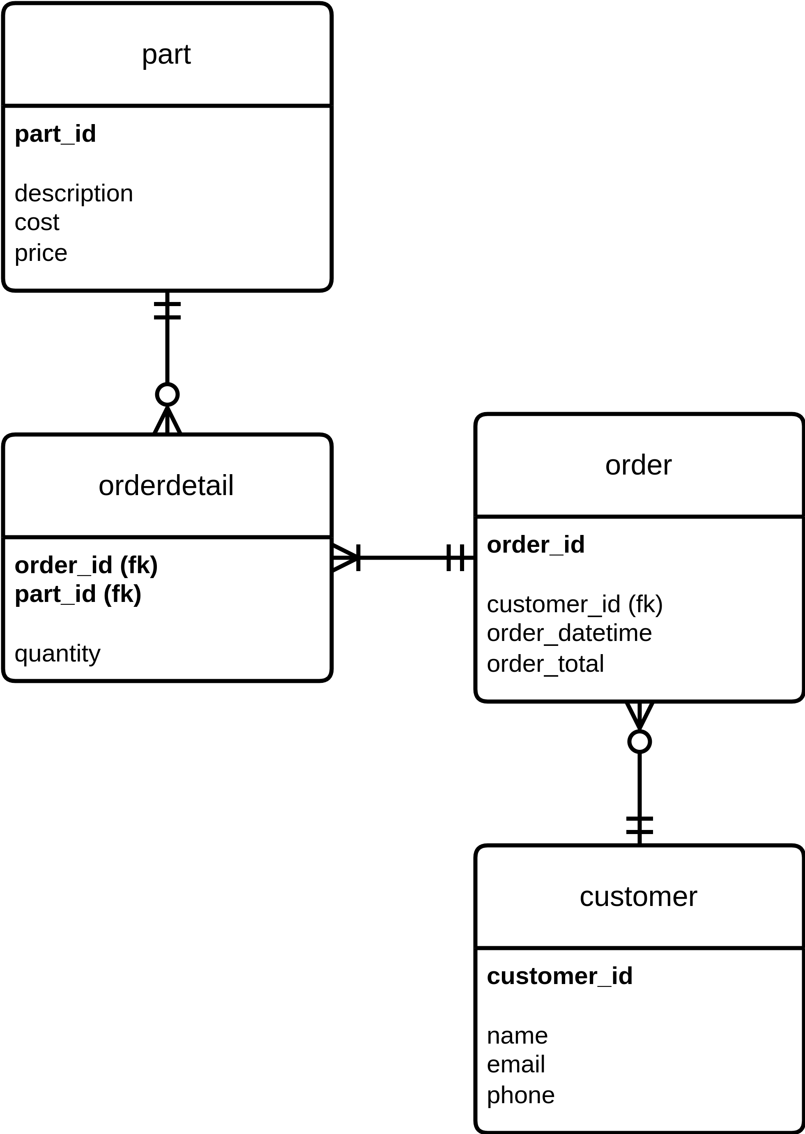
Create Associative Entity to Resolve
Create a table in the middle.
New entity will need a key:
concatenate the foreign keys,
choose attribute to use, or
add a surrogate key.
Now ‘orderdetail’ connects.
An “Event / Transaction Detail” type entity.
LDM - Part Order Customer With Foreign Keys

Slide 11
Specialization Hierarchy in an ERD
Specialization “has a” or
Generalization “is a”.
Comes in Exclusive and Non-Exclusive.
Drawn with a logical ‘or’ shape with an ‘X’ for exclusive.

Slide 12
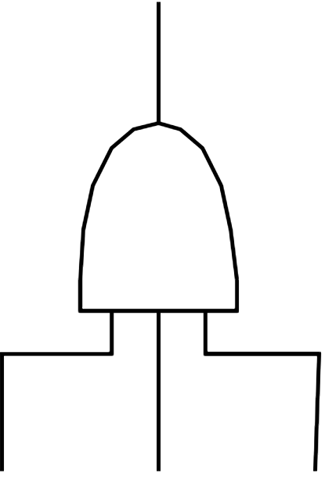
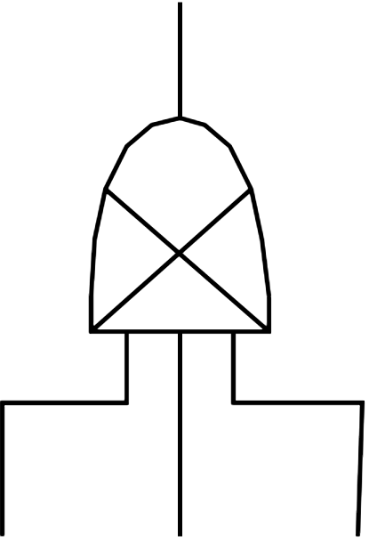
Specialization Hierarchy Shapes
Non-Exclusive Specialization
Exclusive Specialization

Slide 13
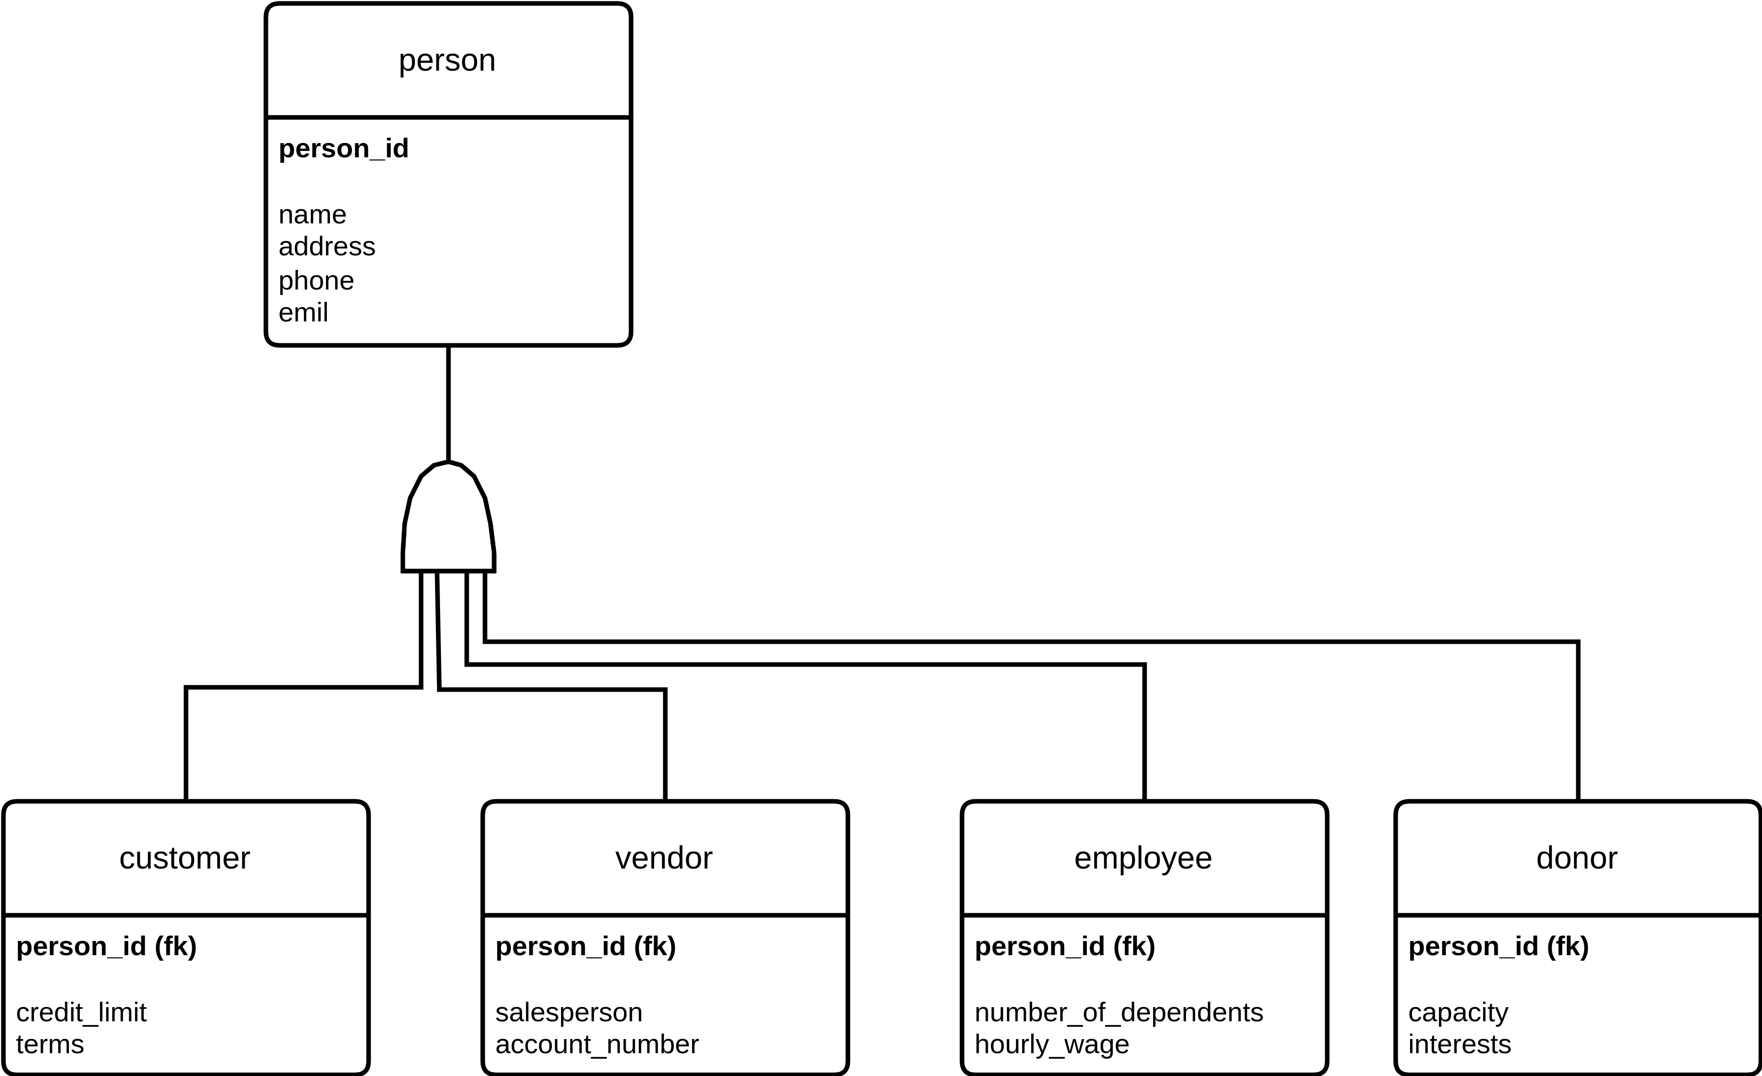
Specialization Hierarchy - Person Non Exclusive
LDM Specialization Hierarchy - Person Non-Exclusive

Slide 14
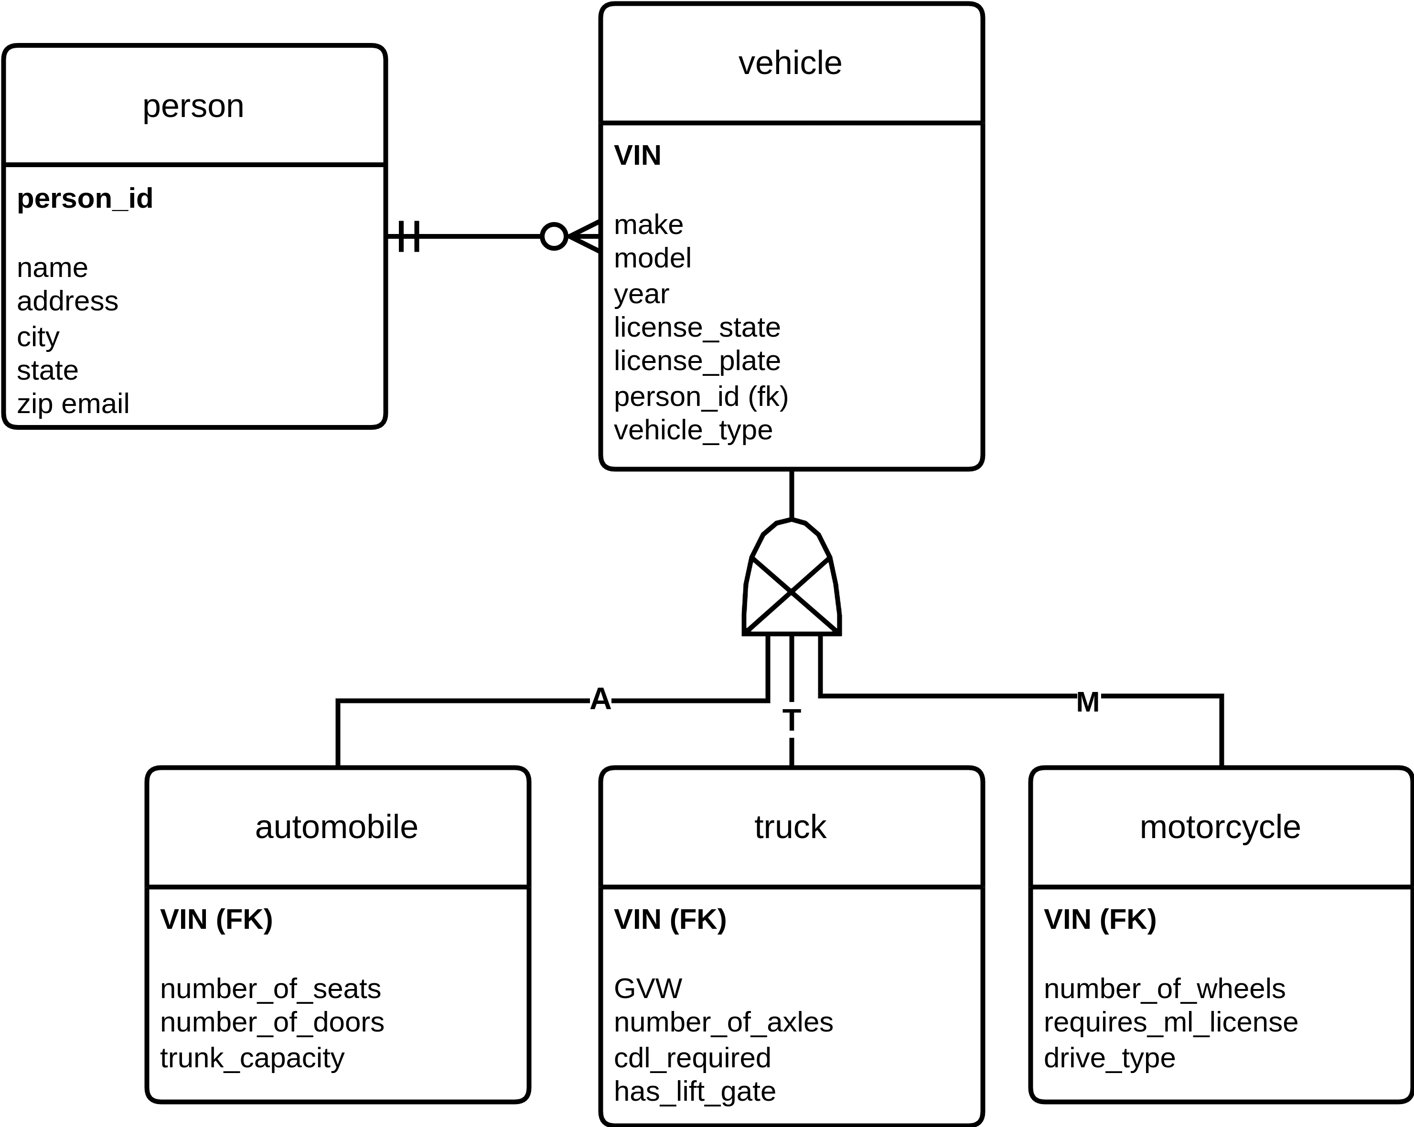
Specialization Hierarchy - Vehicle Exclusive
LDM Specialization Hierarchy - Vehicle Type Exclusive

