Slide 1
Chapter 15 - SQL Dates, Times, and DateTimes - Common
Introduction to Database Systems Modeling and Administration James M. Reneau Ph.D.

Slide 2
Temporal Facts
When.
Dates, Times, and DateTimes.
Each Database does it very differently so each will have own slide desk.

Slide 3
Gregorian Calendar
Twelve months and periodic leap years.
Used since the 16th century.
We will use a 24-hour clock (without AM or PM) with 60 minutes, 60 seconds, and decimal sub-seconds.

Slide 4
ISO-8601 Standard for Date Format
International Standards Organization (ISO).
Thousands of standards that are used in commerce and manufacturing throughout the world.
ISO-8601 defines how to write dates and times as a string.

Slide 5
ISO Date Format
Date Format is defined like below.
Fill in as much as you have.
YYYY-MM-DDTHH:MM:SS.SSSS+00:00 | | | || | | || | YEAR | | |HOUR | Offset +/- MONTH| MINUTE Offset HOUR or Z DAY SECOND Offset MINUTE T or Blank

Slide 6
Sample ISO Dates (without TZ)
2024-06-10
2020-12-31
2020-01-01T01:02:03
2024-06-18 16:58
2022-02-22T12:13:14.5

Slide 7
Time Zones
Bands of time that follow geographic or national borders.
Noon is locally close to the middle if the day.

Slide 8
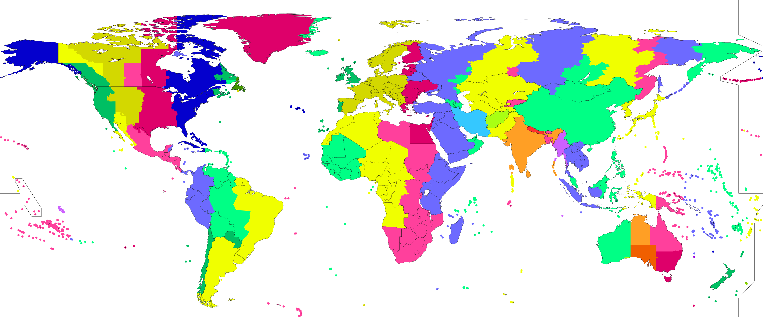
Time Zone Map
World Time Zones

Slide 9
UTC Universal Coordinated Time
Time Zones are expressed as an offset from UTC.
Plus or Minus.
Z is abbreviation for UTC.

Slide 10
Adding Time Zone to ISO Date and Time
Append a “+” or “-” followed by the time offset from UTC.
The abbreviation “Z” may be used for UTC.
Times without a timezone are assumed to be UTC.

Slide 11
Example ISO Dates with Time Zone:
2024-01-04T12:32-04:00
2000-12-31 17:57+01:00
2022-02-22T22:22.123Z

